Slide 1


Slide 2






My SQL Project on
Employee management analysis
Done by: Akshay Kumar Harikoti

Slide 3


INTRODUCTION
PURPOSE:The Employee Management System (EMS) is designed to streamline the management of employee data, job roles, and departmental information within an organization.
TOOLS USED: MY SQL, POWER POINT, CSV
DATA SOURCES: Internal CSV datasets

Slide 4


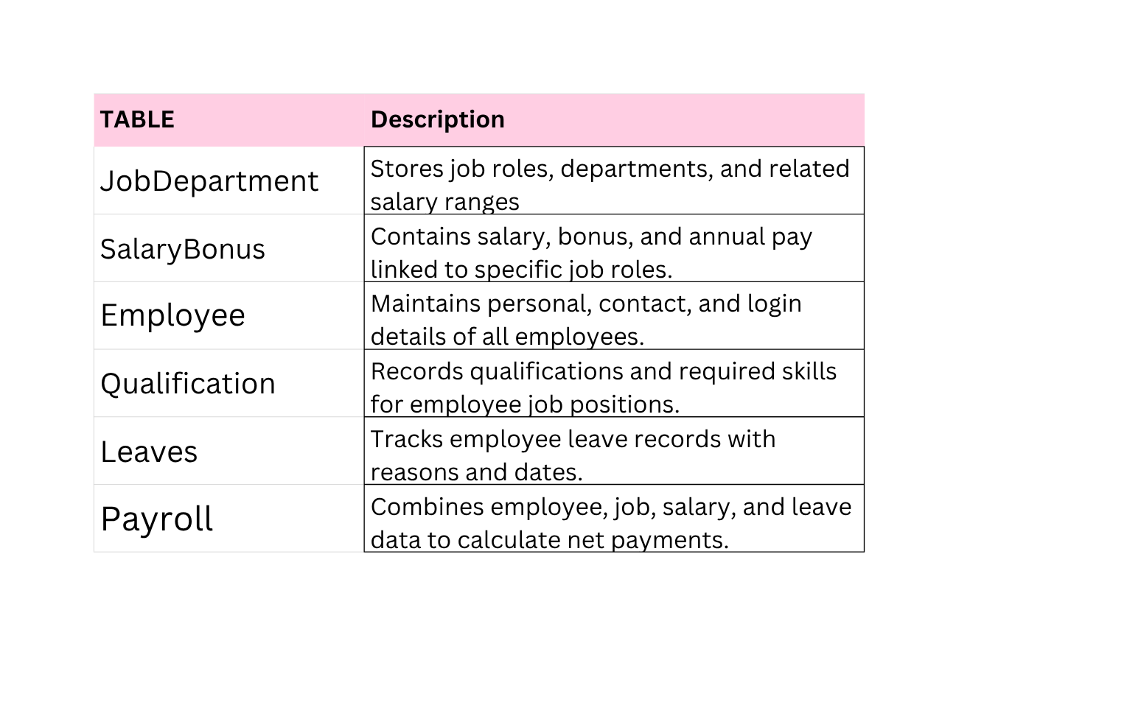
TABLE DESCRIPTIONS

Slide 5
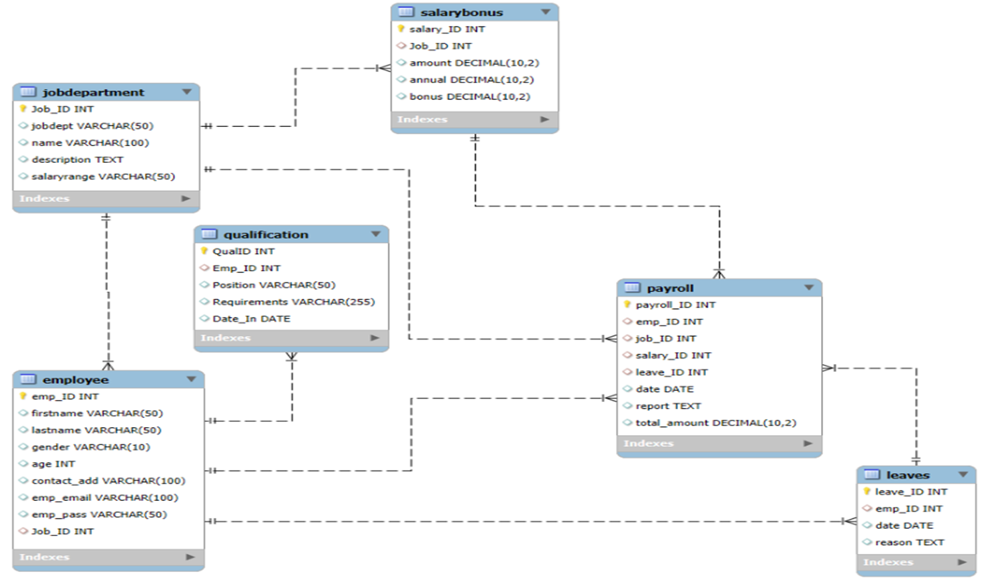




ER DIAGRAM

Slide 6



PROBLEM STATEMENT
1. EMPLOYEE INSIGHTS
2. JOB ROLE AND DEPARTMENT ANALYSIS
3. QUALIFICATION AND SKILLS ANALYSIS
4. LEAVE AND ABSENCE PATTERNS
5. PAYROLL AND COMPENSATION ANALYSIS
6. EMPLOYEE PERFORMANCE AND GROWTH

Slide 7


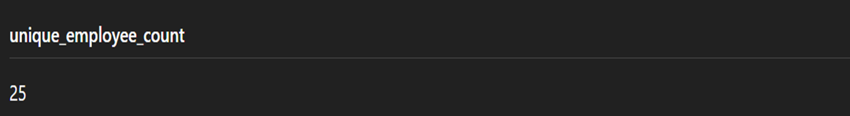


GENERAL AND COMPARATIVE ANALYSIS
How many unique employees are currently in the system?

Slide 8

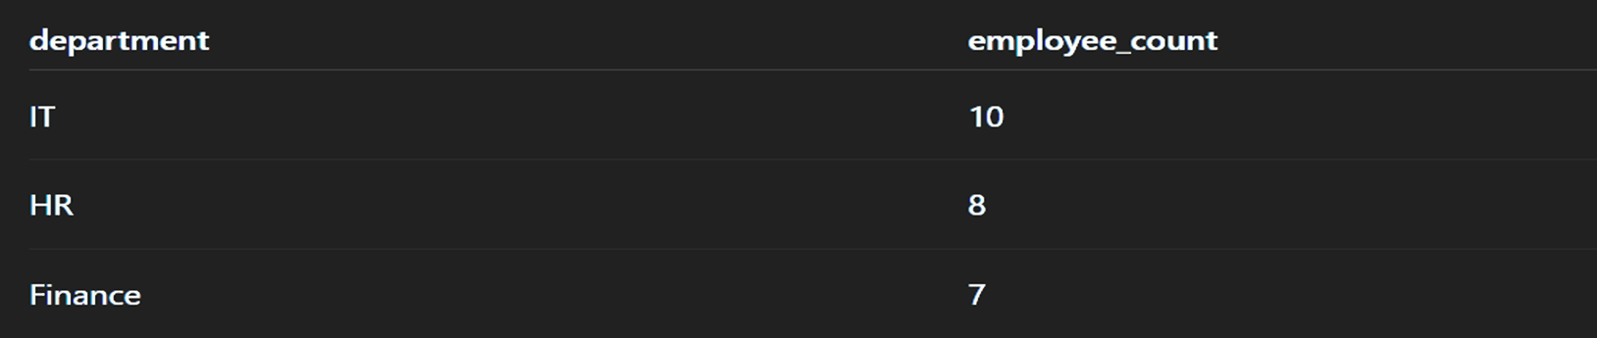


Which departments have the highest number of employees?

Slide 9


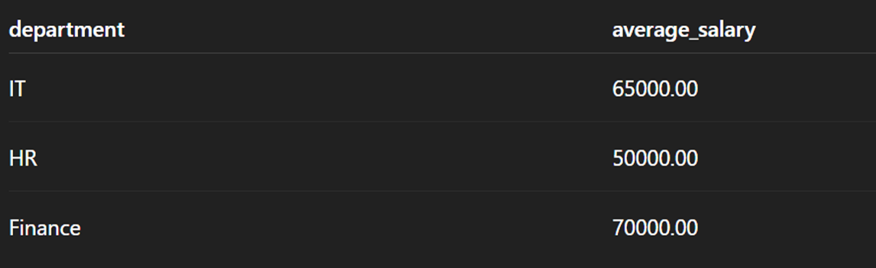
What is the average salary per department?

Slide 10


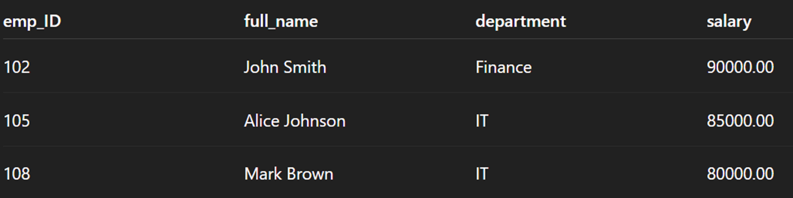

Who are the top 5 highest-paid employees?

Slide 11



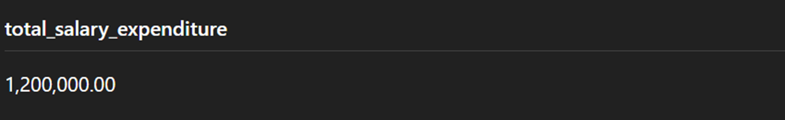
What is the total salary expenditure across the company?

Slide 12


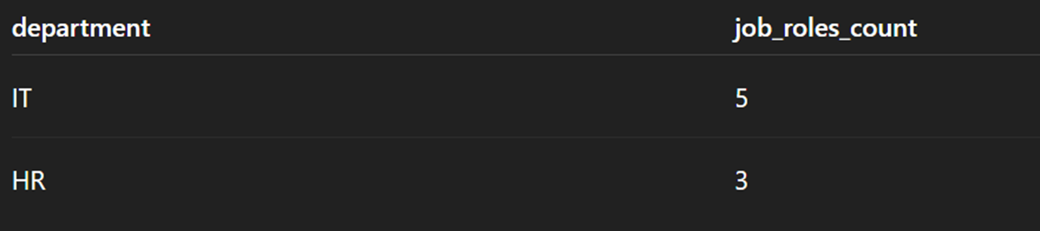
How many different job roles exist in each department?

Slide 13
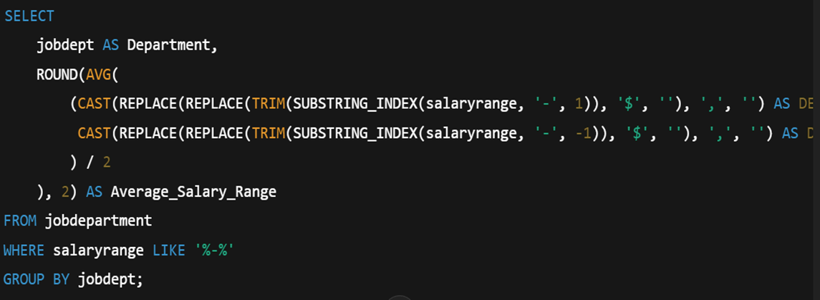


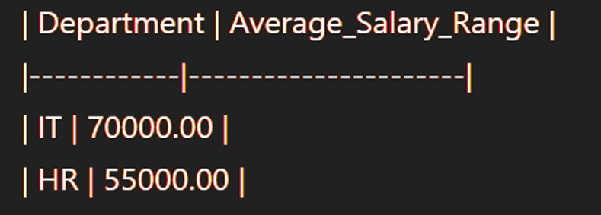
What is the average salary range per department?

Slide 14
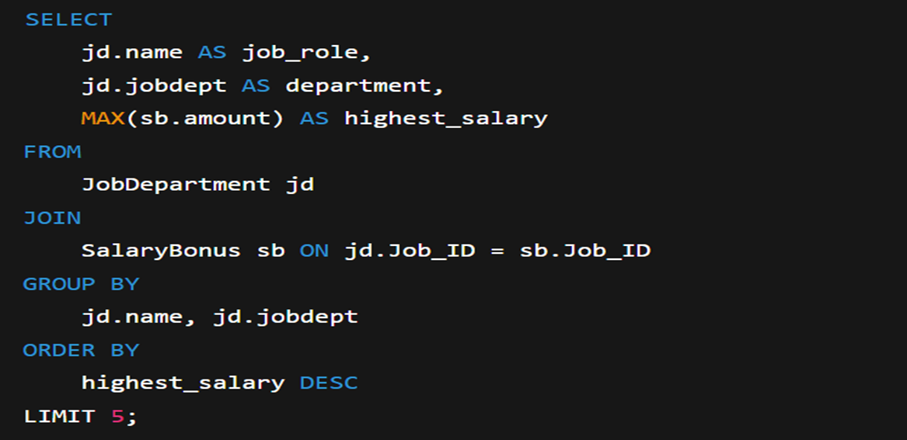


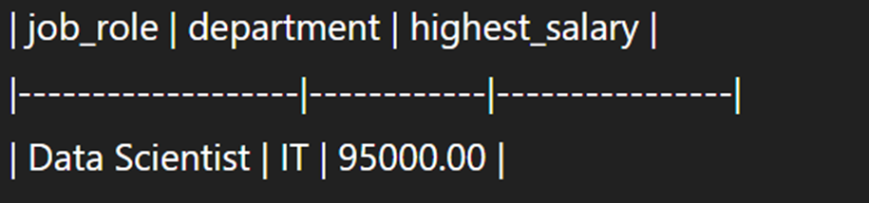
Which job roles offer the highest salary?

Slide 15
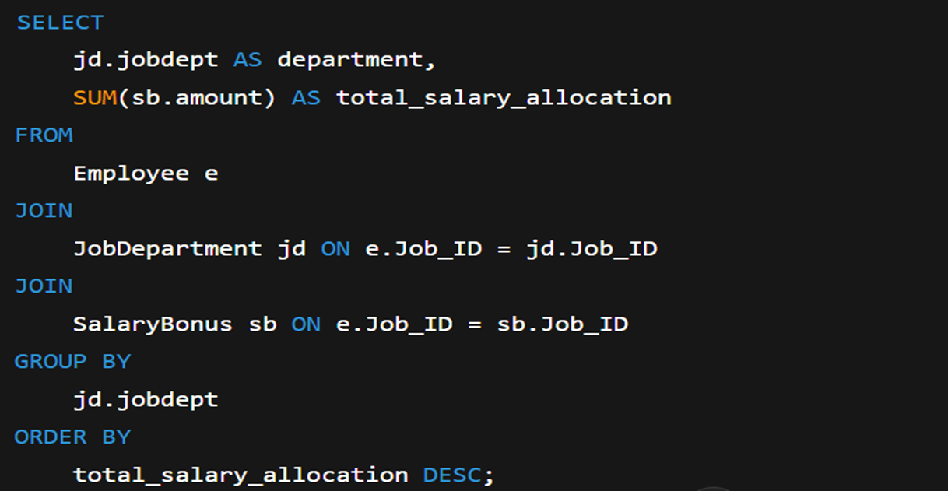


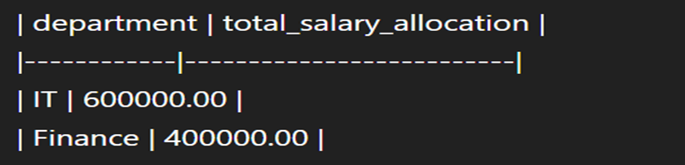

Which departments have the highest total salary allocation?

Slide 16
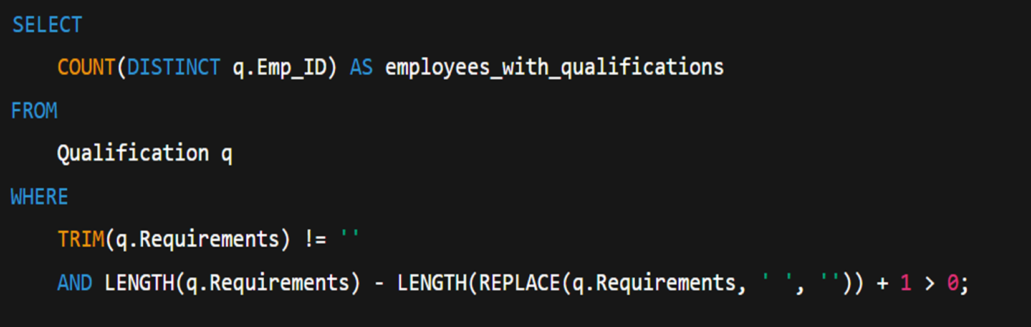


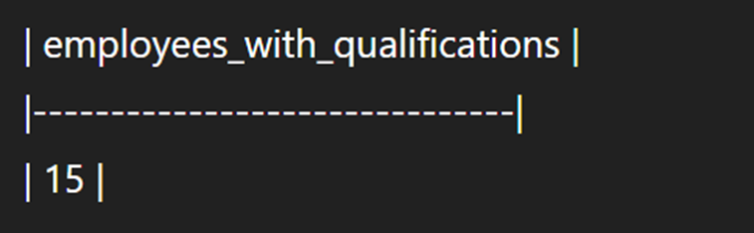

How many employees have at least one qualification listed?

Slide 17



How many employees have at least one qualification listed

Slide 18
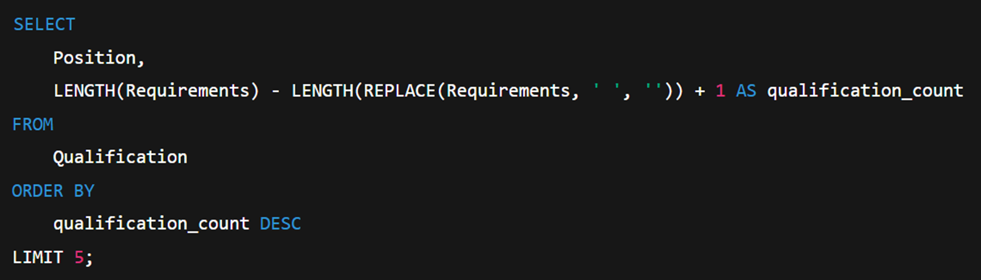

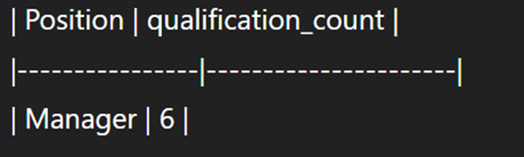


Which positions require the most qualifications?

Slide 19
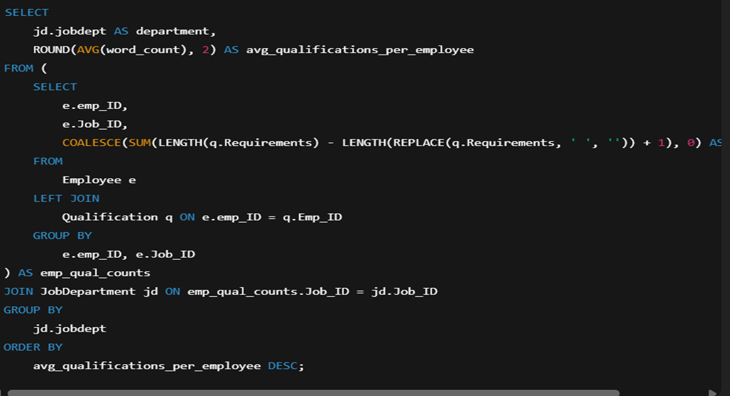

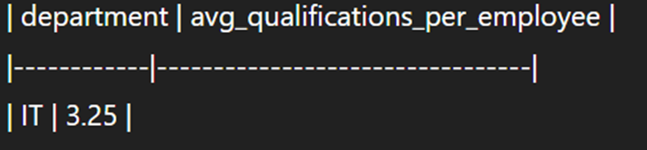

Which employees have the highest number of qualifications?

Slide 20

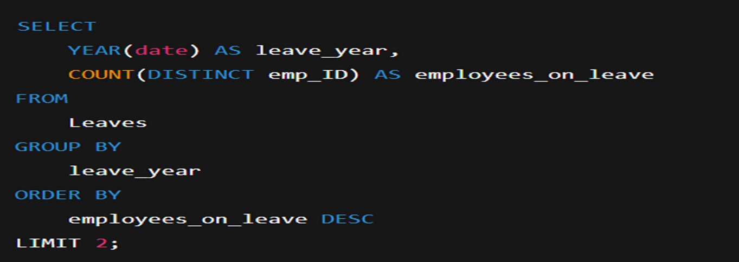


Which year had the most employees taking leaves?

Slide 21
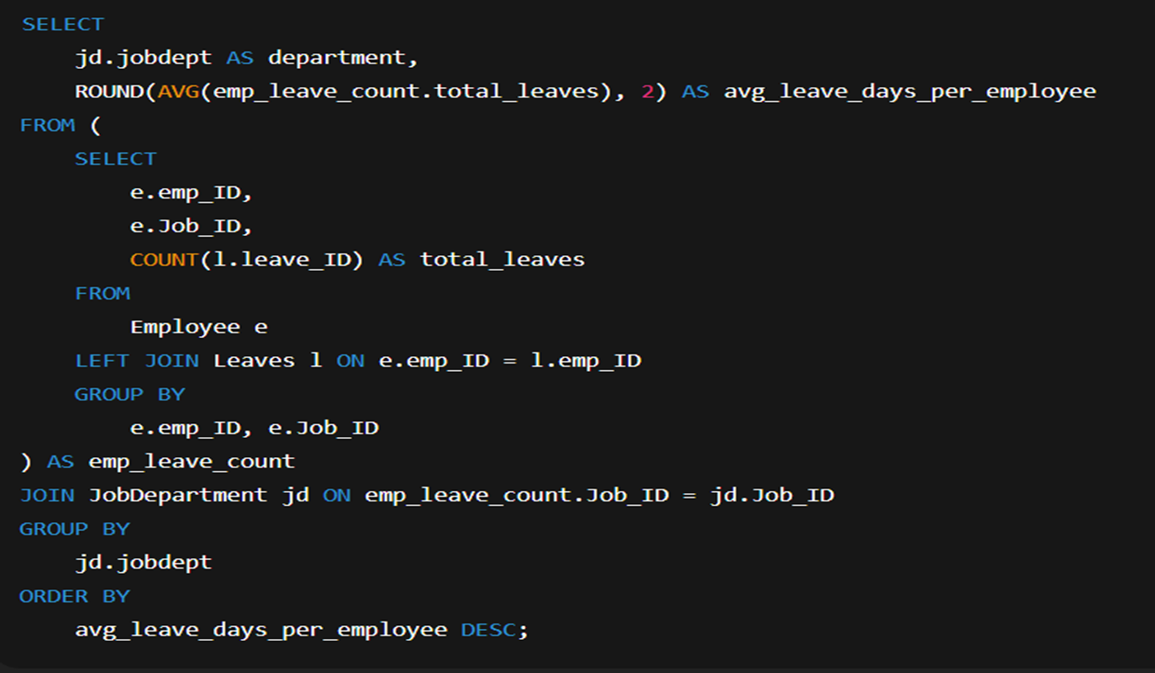



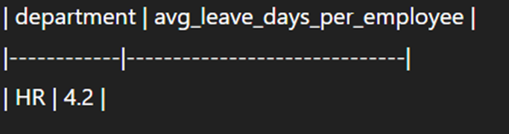

What is the average number of leave days taken by its employees per department?

Slide 22

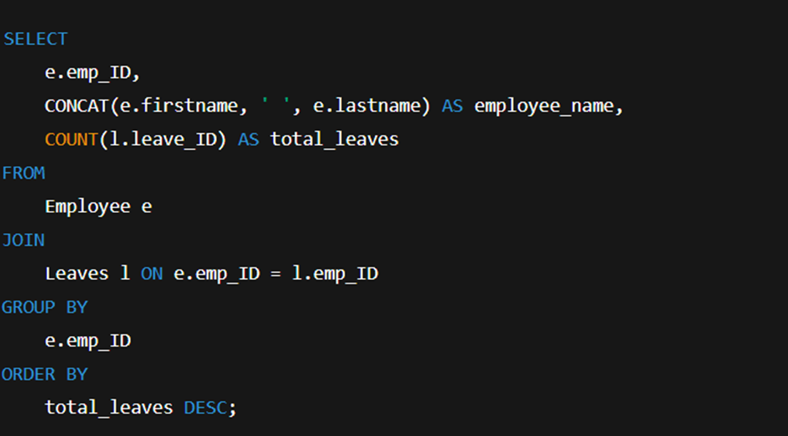


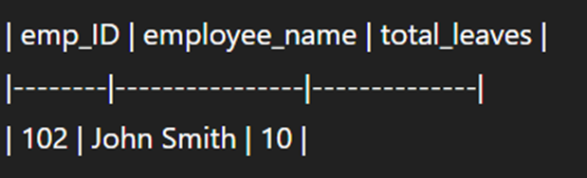
Which employees have taken the most leaves?
1
2
3
4

Slide 23




What is the total number of leave days taken company-wide?

Slide 24


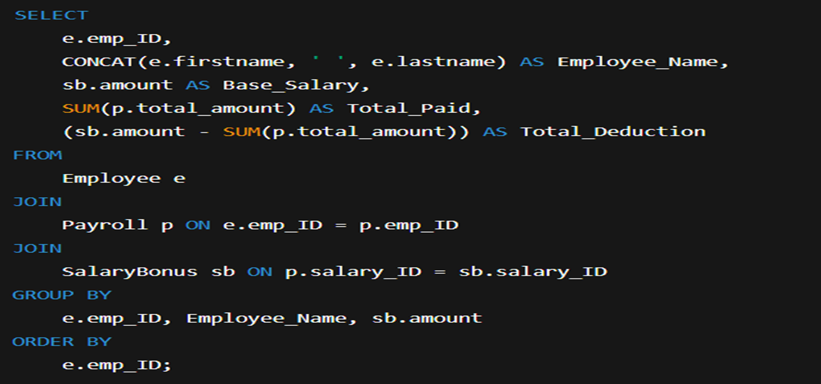



How do leave days correlate with payroll amounts?
Health
Love
Rest
Friends
Travel
Family
Beauty
Talent
Trends
Excitement
Safety

Slide 25
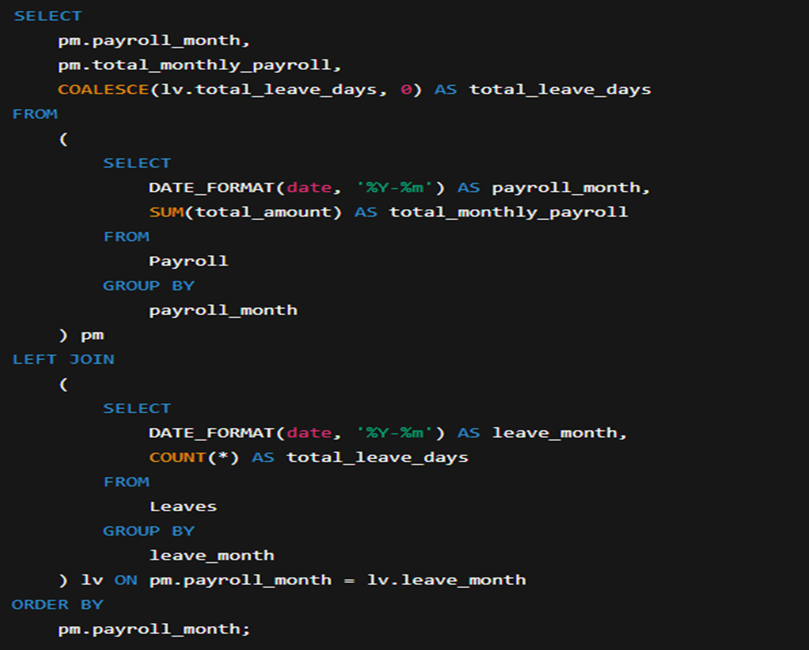


What is the total monthly payroll processed?

Slide 26
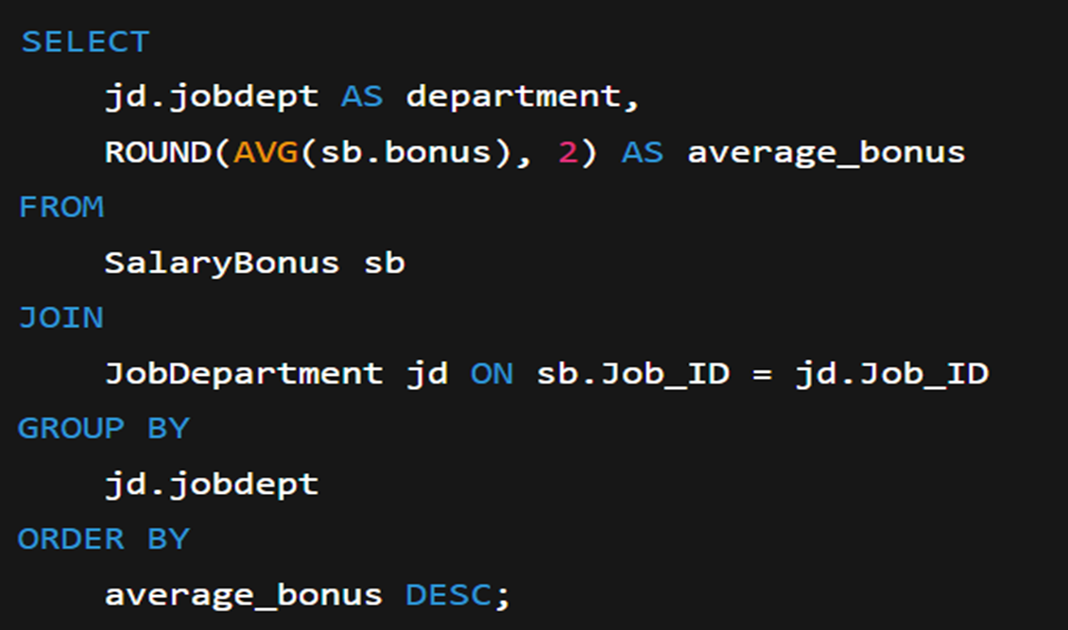



What is the average bonus given per department?

Slide 27
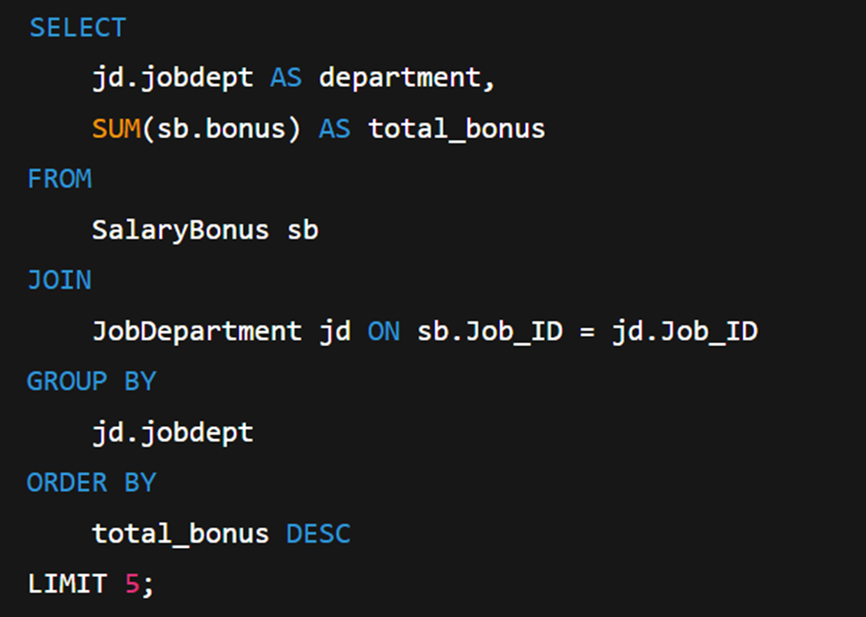

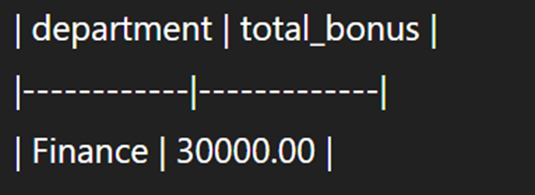

Which department receives the highest total bonuses?

Slide 28

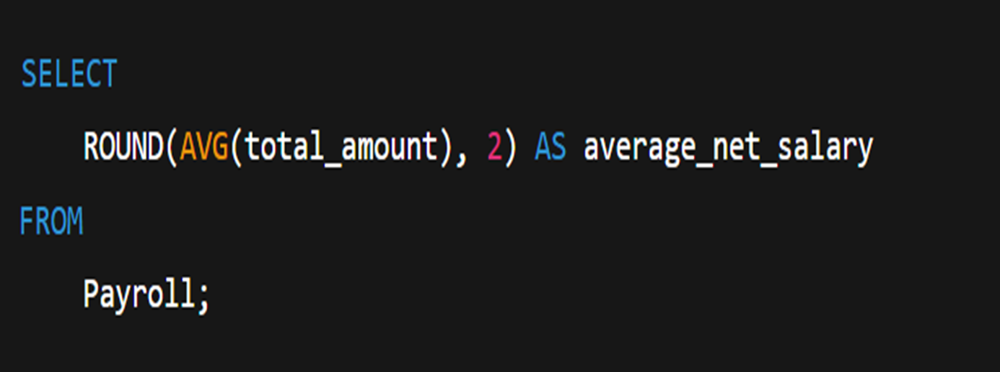

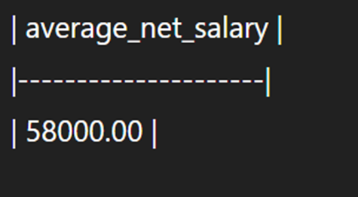
What is the average value of total_amount after considering leave deductions?

Slide 29

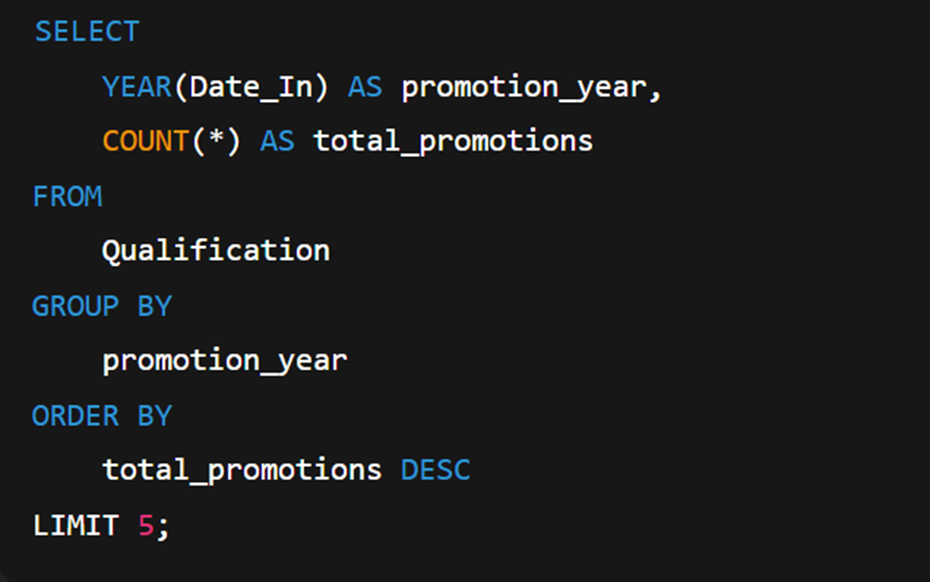


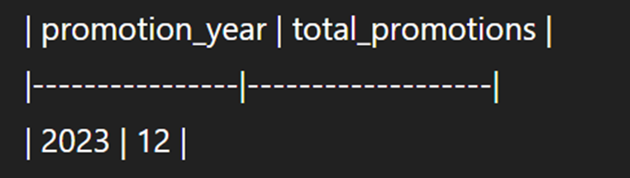
Which year had the highest number of employee promotions?

Slide 30
conclusion
•SQL is a powerful tool for real-time business intelligence.
•Data relationships, when modeled properly, can reveal trends that support data-driven decision-making.
•Automating HR analytics reduces manual effort and increases accuracy, ultimately enhancing operational efficiency.

Slide 31



